Slide 1


ShipmentSure
Machine Learning-Based Delivery Prediction System
Predicting On-Time vs Delayed Shipments
Presented by: Pranav Ghorpade

Slide 2


The Challenge in Modern Logistics
Why Delivery Prediction Matters
Supply chains face significant disruptions from unpredictable delays caused by weather, carrier performance, and route complexity. Manual prediction methods are unreliable and time-consuming, leaving companies reactive rather than proactive.
Organizations need a data-driven system to accurately forecast delivery outcomes, reduce costs, and improve customer satisfaction.

Slide 3

Project Objectives
01
02
03
Analyze Shipment Data
Identify Key Delay Factors
Build ML Models
Deep dive into historical patterns and delivery factors
Determine which variables most impact delivery outcomes
Train and compare multiple machine learning algorithms
04
05
Deploy User-Friendly App
Provide Probability-Based Insights
Create accessible interface for real-time predictions
Deliver actionable predictions with confidence scores

Slide 4


Dataset Overview
Dataset Size
Key Features
~10,000 shipment records with comprehensive feature coverage
Supplier rating
Lead time
Route distance
Weather conditions
Carrier performance
Delivery days
Target Variable
On-Time (1) or Delayed (0) classification for each shipment

Slide 5

Exploratory Data Analysis
Key Findings
The EDA phase revealed critical patterns in shipment performance. Target imbalance was observed between on-time and delayed deliveries, requiring careful model evaluation strategies.
Strong correlations emerged:
Route distance significantly impacts delay probability
Weather conditions create predictable disruption patterns
Supplier ratings correlate with delivery performance
Delivery days show strongest correlation with outcomes

Slide 6

Feature Engineering Strategy
Derived Features
Encoding Methods
Data Preprocessing
Total Order Value
Applied one-hot encoding for categorical variables including carrier type, weather conditions, and route categories
Standardized numeric columns to ensure consistent scale across all features for optimal model performance
Delivery Days
Long-Distance Flag
High Supplier Rating Flag

Slide 7



Model Development & Evaluation
XGBoost (Selected)
Random Forest
Achieved best overall performance
Logistic Regression
Improved accuracy through ensemble learning
Established baseline performance metrics
Evaluation Metrics
Accuracy
Recall
Precision
F1-Score

Slide 8







Model Performance Results
Best Performance
High Recall
XGBoost achieved optimal balance across all metrics
Excellent detection rate for delayed shipments - critical for operations
Strong Generalization
Consistent performance on unseen test data
The XGBoost model provided the best trade-off between precision and recall, especially in identifying delayed shipments, which is critical for proactive decision-making and resource allocation.

Slide 9





System Architecture
User Input
Shipment details entered via web interface
Preprocessing
Data transformation and feature engineering
Model Prediction
XGBoost model loaded from best_model.pkl
Results Display
Prediction with probability score shown to user

Slide 10
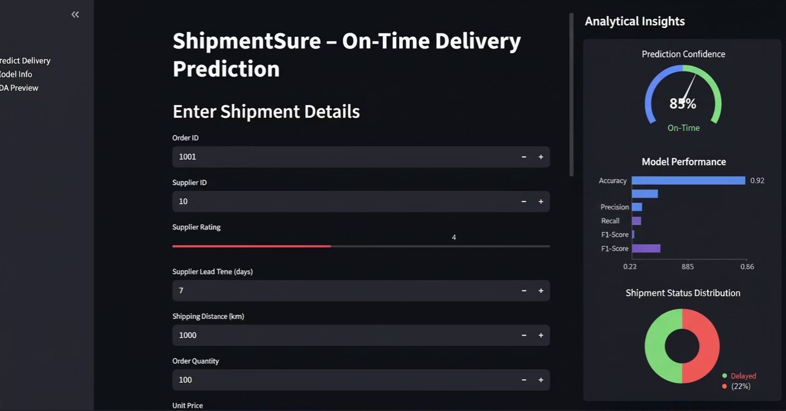
Streamlit Application Demo
Key Features
Clean, intuitive user interface
Real-time prediction engine
Probability confidence scores
Model information page
EDA preview for transparency
User Experience
Users enter shipment details through a simple form. The system instantly processes inputs using the same pipeline as training, then displays the prediction with a probability percentage - enabling informed decision-making.
All deliverables completed: GitHub repository, documentation, trained model (best_model.pkl), deployed Streamlit app, and comprehensive reports.

